Slide 1

CLOUD BASED BUS TICKET SYSTEM Project Synopsis Presentation Date: 23/09/2022
Course Name (Course Code)
Degree : BCA(CTIS)I-NURTURE
Project Guide:
MR. Vijay Prakash sir
ABHAY SAXENA (TCA2056003)
DEEKSHA AGARWAL (TCA2056008)
BOBY SHARMA(TCA2056007)
VIKESH KUMAR(TCA2056026)
FACULTY OF ENGINEERING & COMPUTING SCIENCES
TEERTHANKER MAHAVEER UNIVERSITY, MORADABAD

Slide 2

Team Details
Student Name | Role
ABHAY SAXENA , VIKESH KUMAR | Research , Designing, Prototype
BOBY SHARMA , DEEKSHA AGARWAL | Coding , Data structue
Guidelines: Mention Team Names & their role in project
2
T011A/ Template Version 5.0

Slide 3
Table of Contents
1. INTRODUCTION
2.WHAT IS CLOUD
3.LANGUAGES USED
4.CLOUD PLATFORM USED
5.LIST OF FIGURES
6.ADVANTAGES
7.SOME GLIMPES OF PROJECT
Guidelines: Mention brief about the project and it’s functions/ modules
3
T011A/ Template Version 5.0

Slide 4
INTRODUCTION
Overview
This system was intended to develop an application for U.P.S.R.T.C to perform functionalities like accessing the basic information of a student from educational institutions for authentication and provide Bus pass to a particular student without placing him/her in a queue for a long time.
Online Student Bus Pass Generation system is helpful to U.P.S.R.T.C by reducing the paper work, time consumption and makes a process of getting Bus pass as simple and fast.
4
T011A/ Template Version 5.0

Slide 5
Objective
Bus pass system is a web application for students to get bus passes through online. Before this application implementation the manual process is used to do the process of issuing the bus pass to the passenger. This manual process requires man power and is more time consuming. To avoid such difficulties we implemented this system.
The key components of bus pass system is
Bus pass generation
Bus pass renewal
5
T011A/ Template Version 5.0

Slide 6
WHAT IS CLOUD
Cloud computing is the on-demand delivery of compute power, database and other IT resources via the internet with pay-as-you-go pricing.
A cloud services platform provides rapid access to flexible and low cost IT resources.
Cloud computing is a general term for anything that involves delivering hosted services over the Internet.
Example: Google Drive, Apple iCloud, Amazon Cloud Drive etc.
6
T011A/ Template Version 5.0

Slide 7
LANGUAGES USED
HTML
CSS
PHP
JAVA SCRIPT
7
T011A/ Template Version 5.0

Slide 8
CLOUD PLATFORM USED
Amazon web services
Amazon web service is a platform that offers flexible, reliable, scalable, easy-to-use and cost-effective cloud computing solutions.
The platform is developed with a combination of infrastructure as a service (IaaS), platform as a service (PaaS) and packaged software as a service (SaaS) offerings.
8
T011A/ Template Version 5.0

Slide 9
AWS COMPUTE SERVICES : STORAGE
uEC2(Elastic Compute Cloud) - EC2 is a virtual machine in the cloud on which you have OS level control. You can run this cloud server whenever you want.
uAWS Lambda — This AWS service allows you to run functions in the cloud. The tool is a big cost saver for you as you to pay only when your functions execute.
uAmazon S3 or Amazon Simple Storage Service is a service offered by AWS that provides object storage through a web service interface. Amazon S3 uses the same scalable storage infrastructure that Amazon.com uses to run its global E-commerce network.
9
T011A/ Template Version 5.0

Slide 10
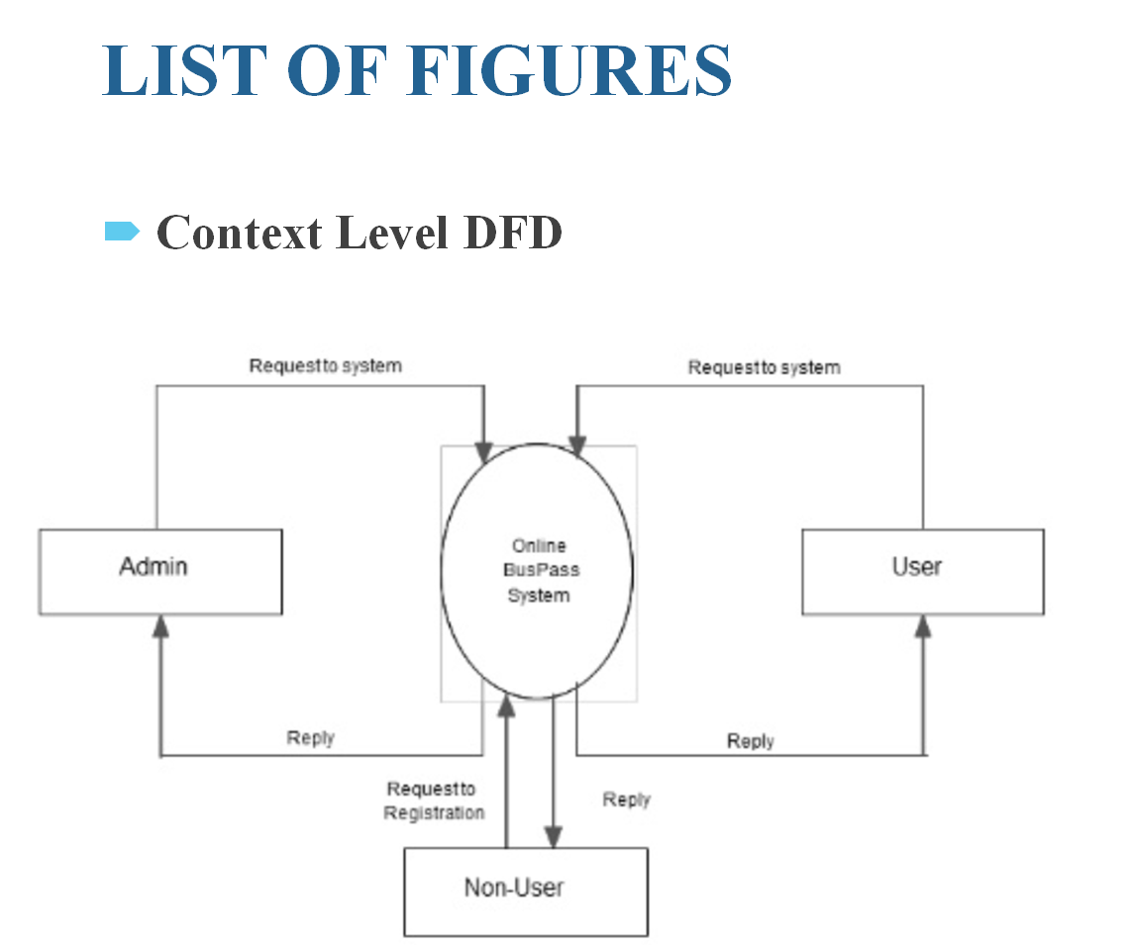
Context Diagram (Overall Project)
10
T011A/ Template Version 5.0

Slide 11
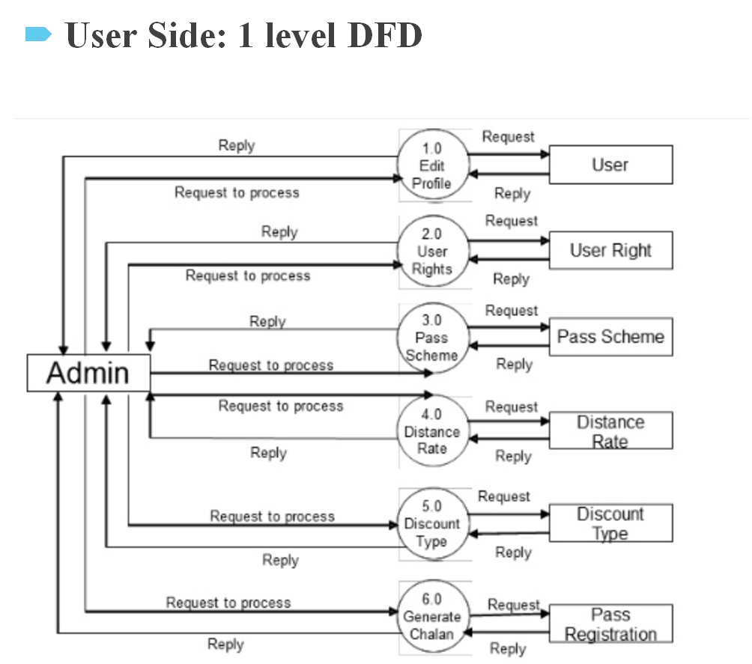
Context Diagram (Overall Project)
11
T011A/ Template Version 5.0

Slide 12
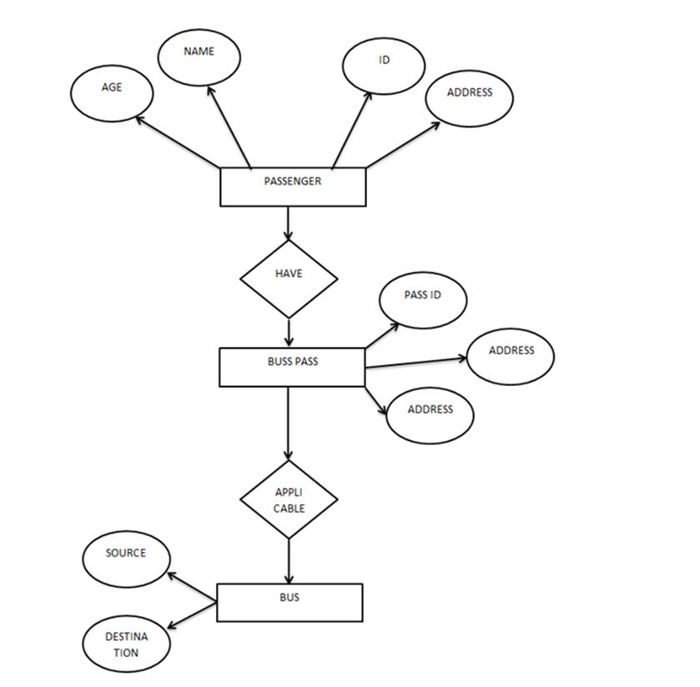
Entity Relationship Diagram (ERD)
12
T011A/ Template Version 5.0

Slide 13
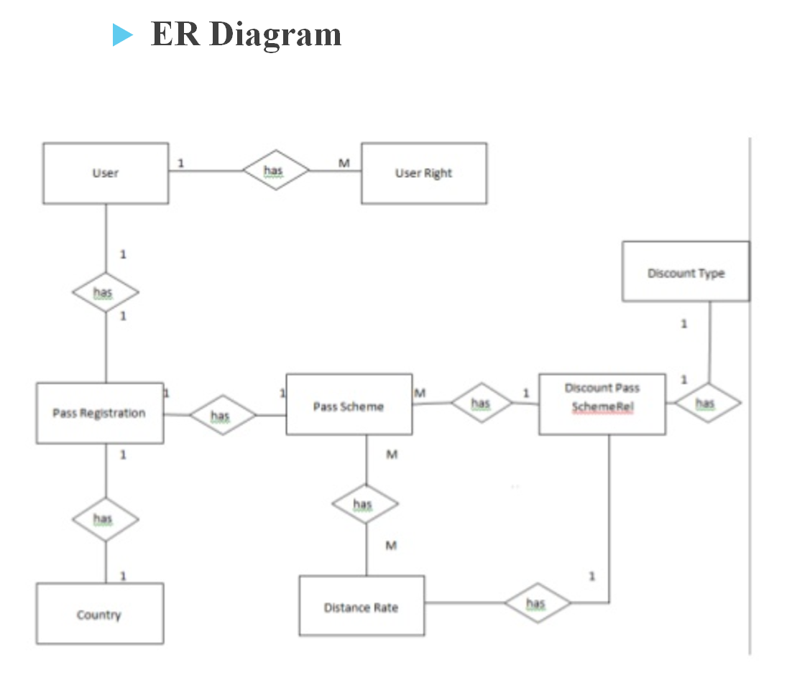
Entity Relationship Diagram (ERD)
13
T011A/ Template Version 5.0

Slide 14
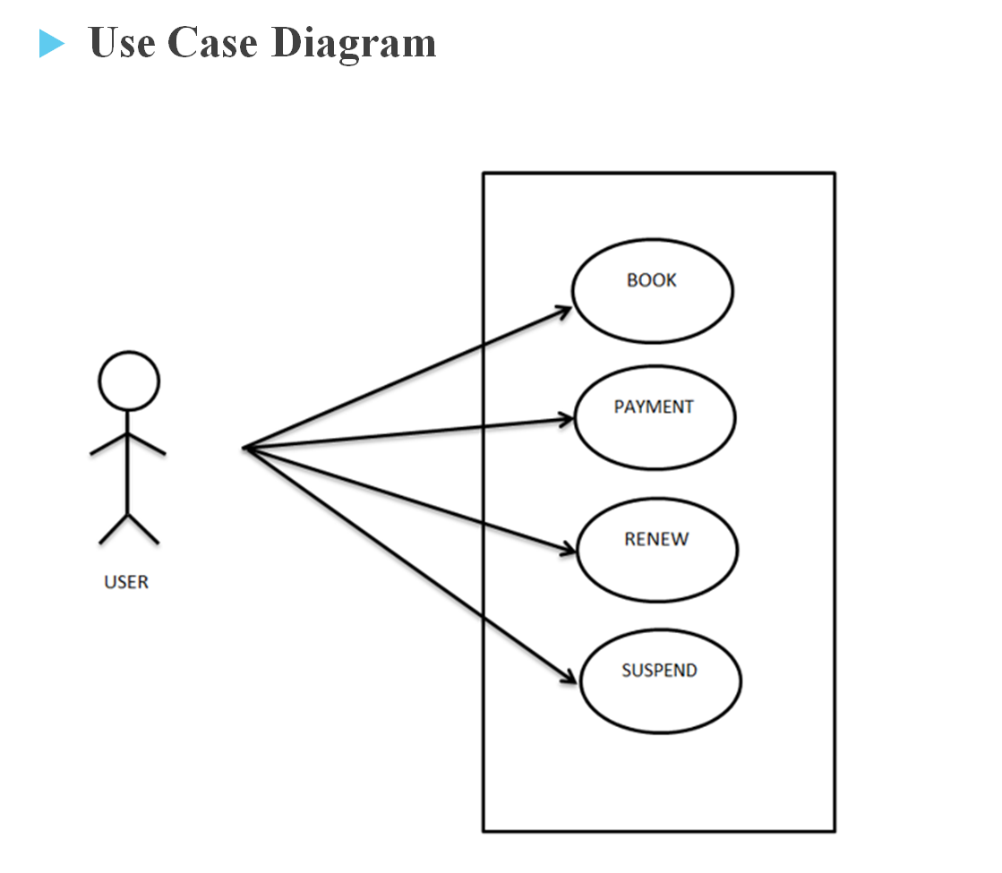
Use Case Diagram
Guidelines: This slide is optional. May add more slide, if the details are available
14
T011A/ Template Version 5.0

Slide 15
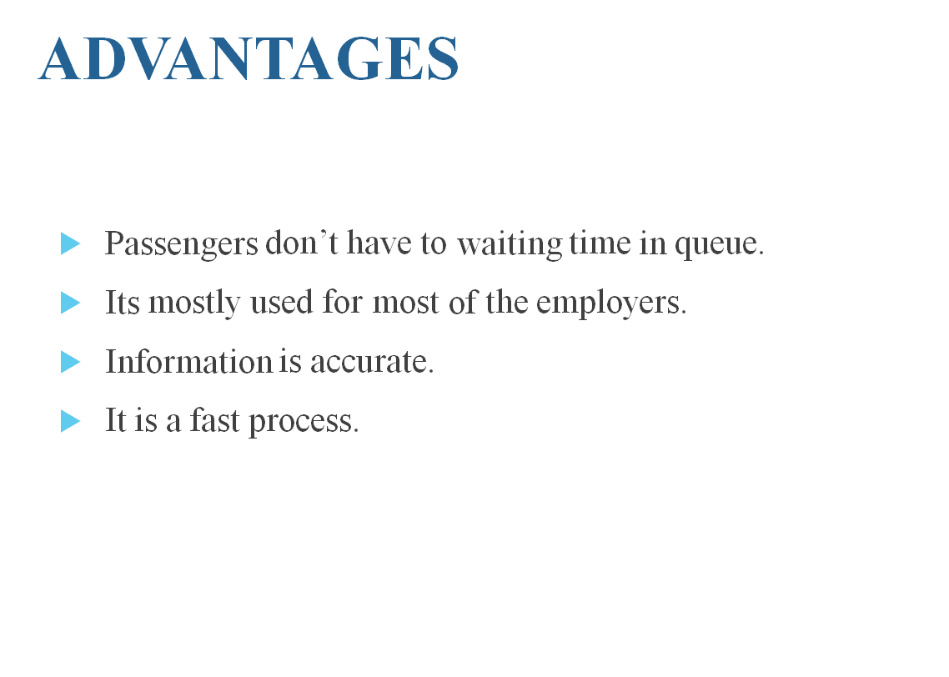
\
Advantage of The Project
Guidelines: Mention advantage from this project, the audience/ users who will get benefitted
15
T011A/ Template Version 5.0

Slide 16
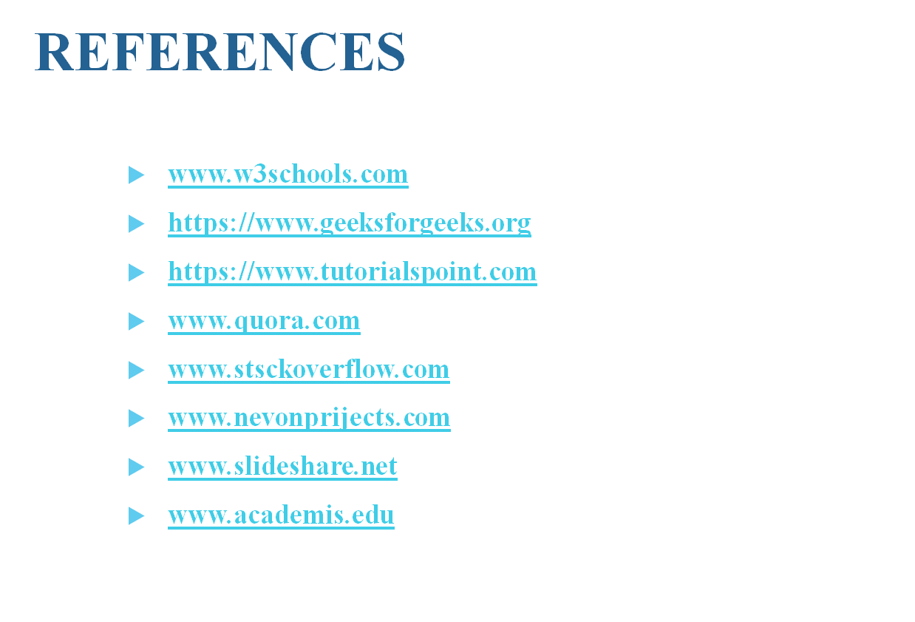
REFERENCES
16
T011A/ Template Version 5.0

Slide 17

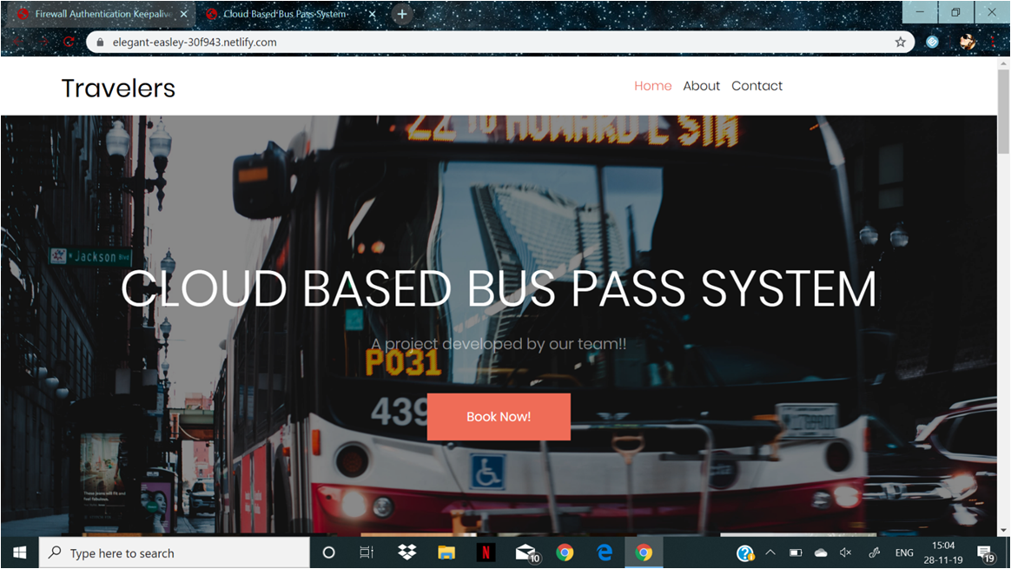
SOME GLIMPES OF PROJECT
17
T011A/ Template Version 5.0

Slide 18

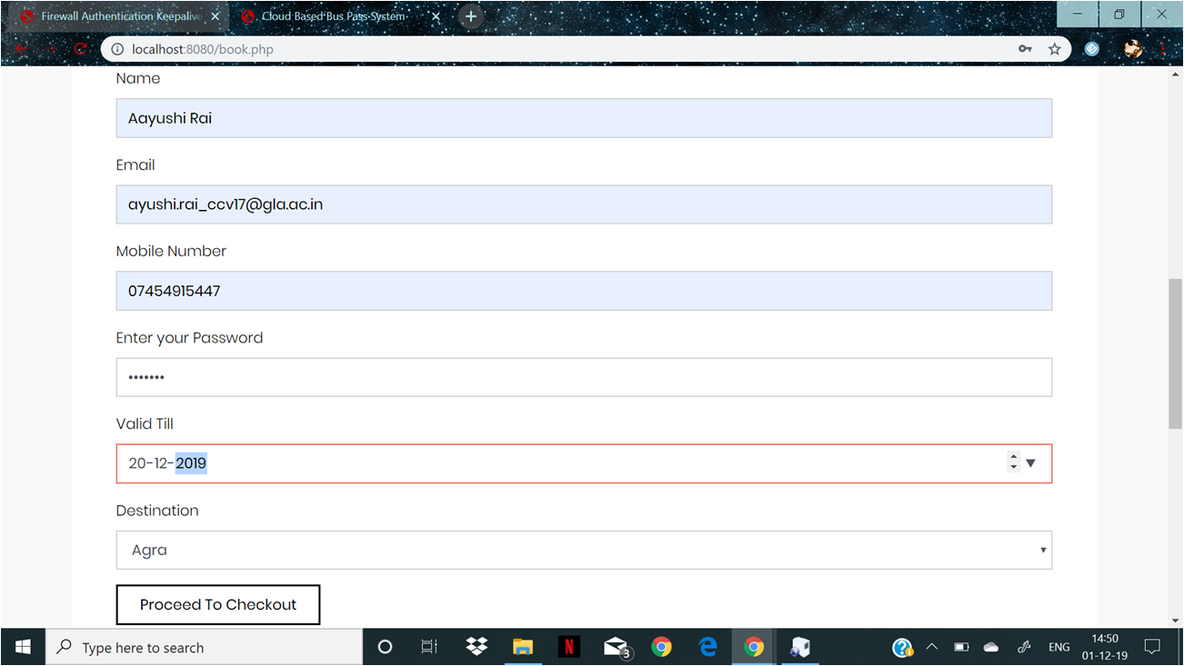
SOME GLIMPES OF PROJECT
18
T011A/ Template Version 5.0

Slide 19
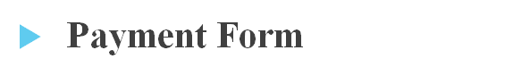
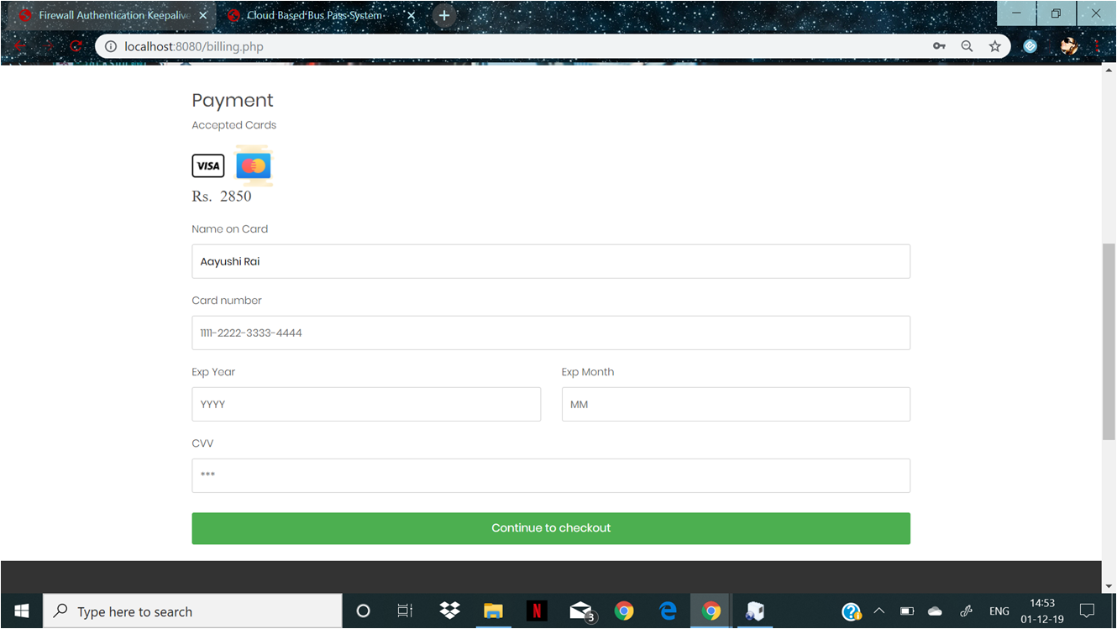
SOME GLIMPES OF PROJECT
19
T011A/ Template Version 5.0

Slide 20
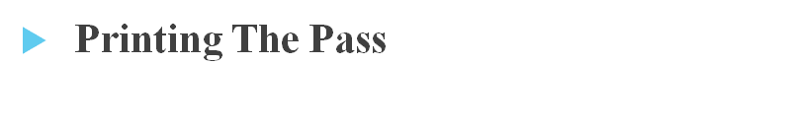
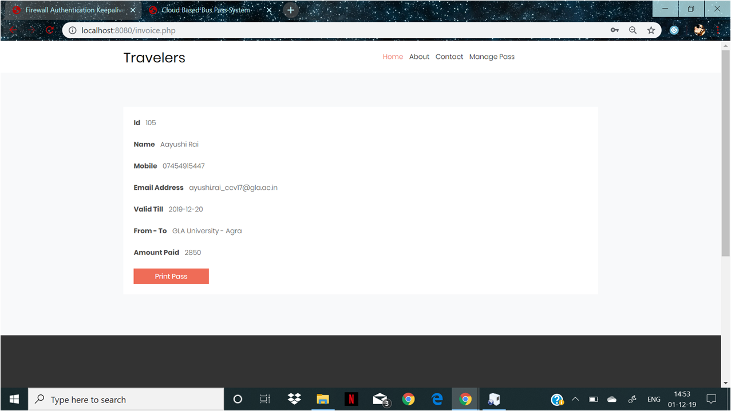
SOME GLIMPES OF PROJECT
20
T011A/ Template Version 5.0

Slide 21

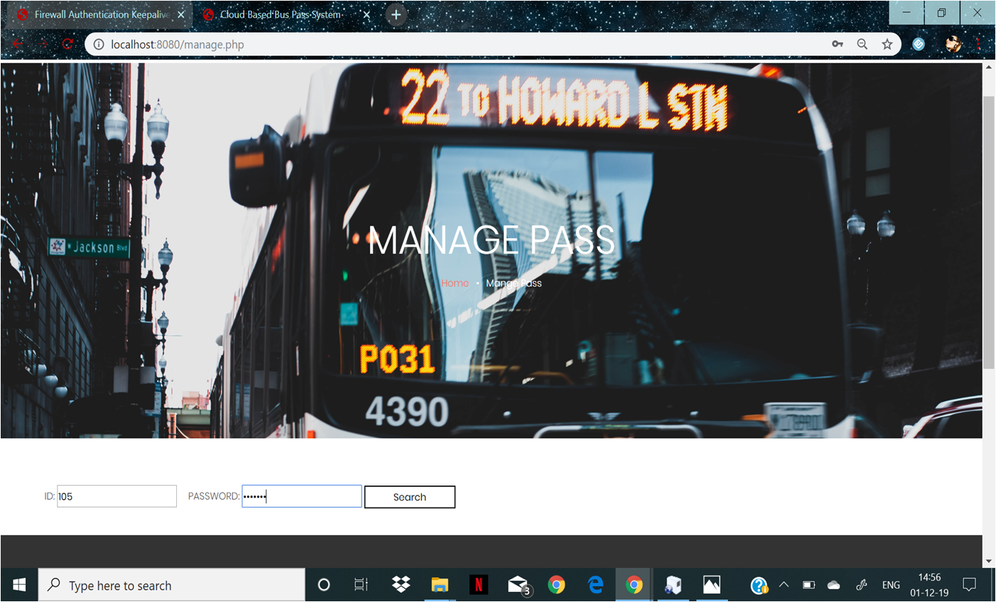
SOME GLIMPES OF PROJECT
21
T011A/ Template Version 5.0

Slide 22

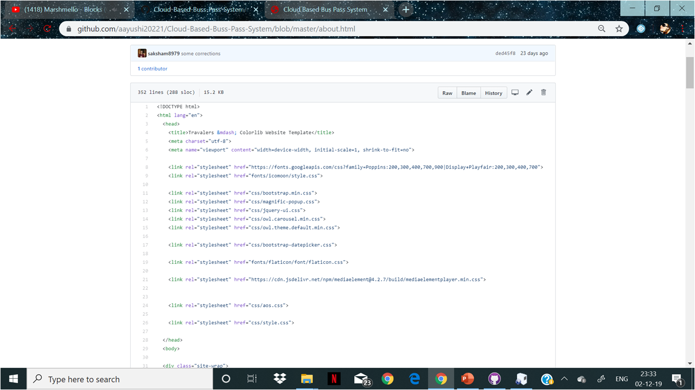
SOME GLIMPES OF PROJECT
22
T011A/ Template Version 5.0

Slide 23
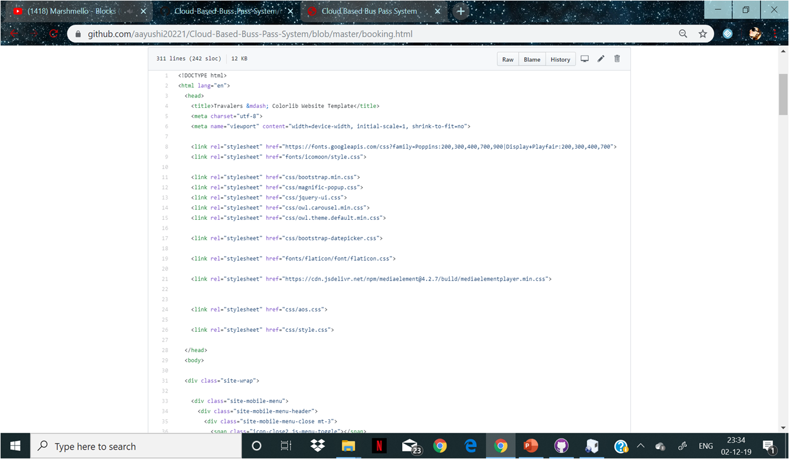
SOME GLIMPES OF PROJECT
23
T011A/ Template Version 5.0

Slide 24

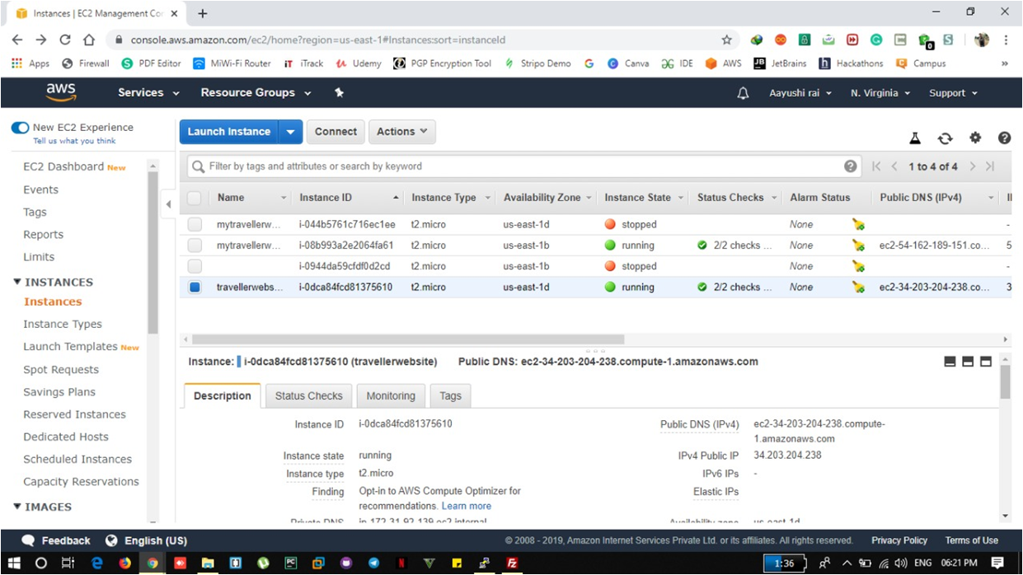
SOME GLIMPES OF PROJECT
24
T011A/ Template Version 5.0

Slide 25
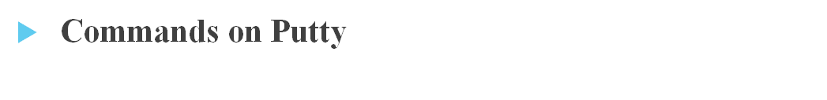
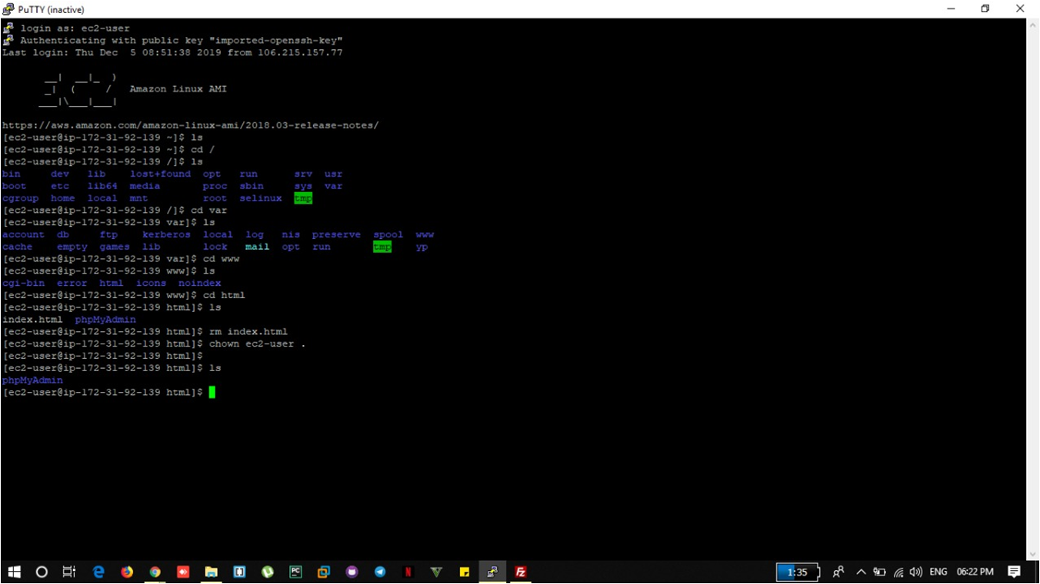
SOME GLIMPES OF PROJECT
25
T011A/ Template Version 5.0

Slide 26

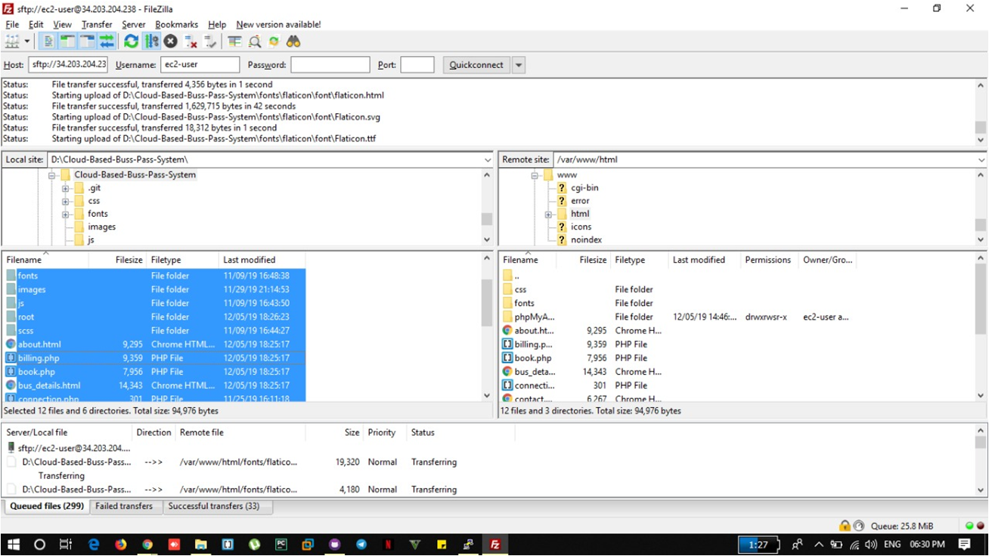
SOME GLIMPES OF PROJECT
26
T011A/ Template Version 5.0

Slide 27

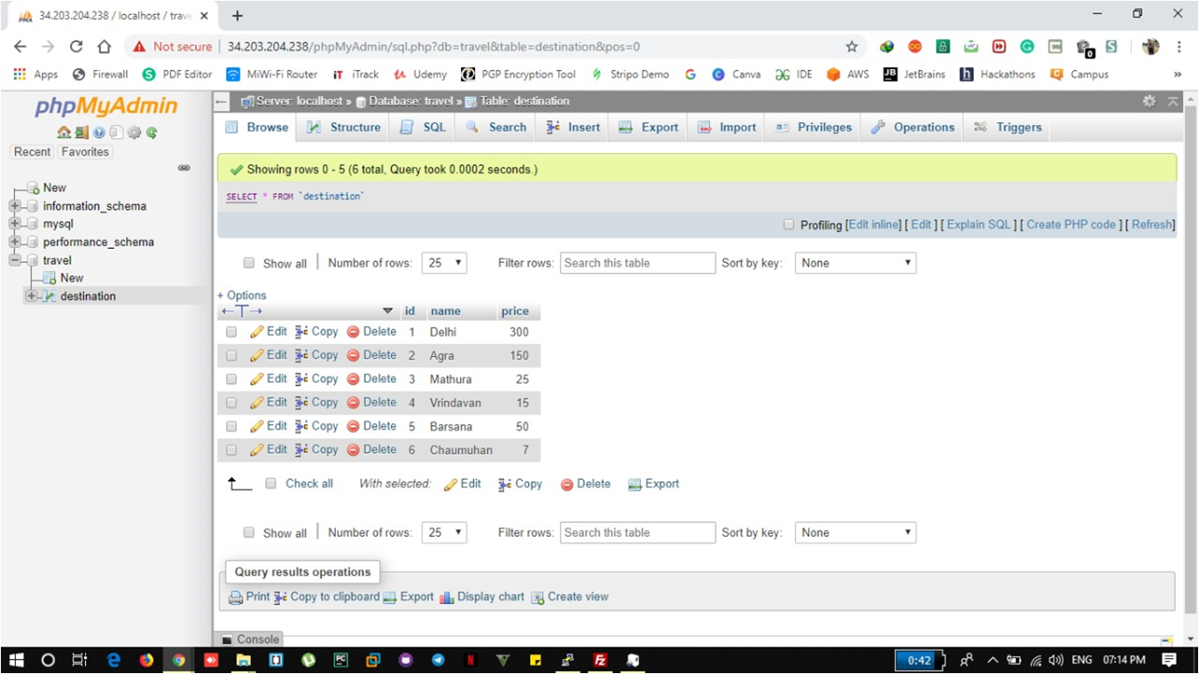
SOME GLIMPES OF PROJECT
27
T011A/ Template Version 5.0

Slide 28
THANKS

